Slide 1
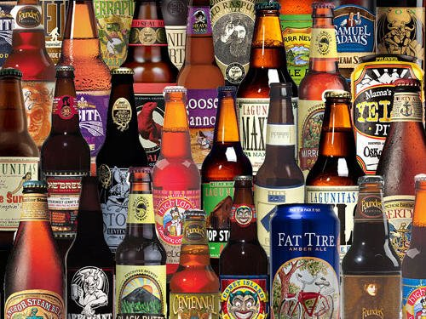
Craft Cans

Slide 2
About
Craft Cans is an app to help people find a new craft beer to try that is similar to the beers that they usually consume

Slide 3
“I want to try a new beer…”
What type of beer?
Amber Ale
Dunkelweizen
Gose
Hefeweizen
India Pale Ale
Porter
Saison
Stout
Etc….

Slide 4
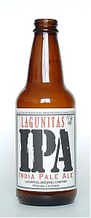
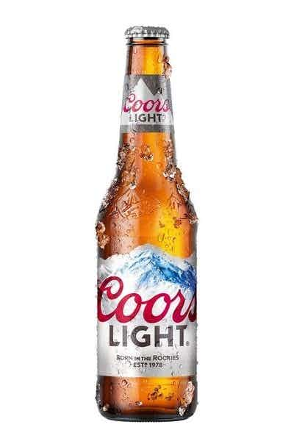
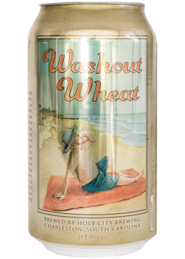
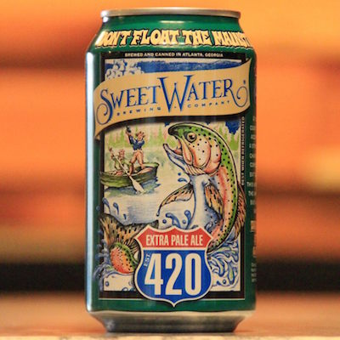
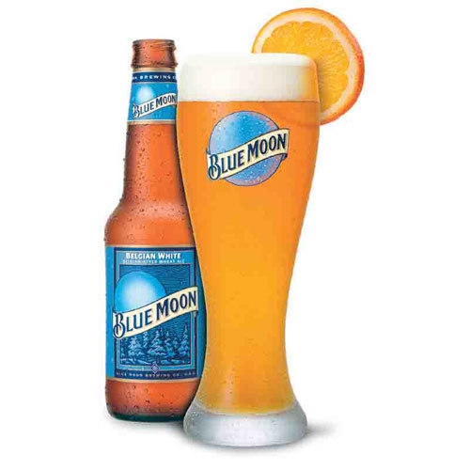
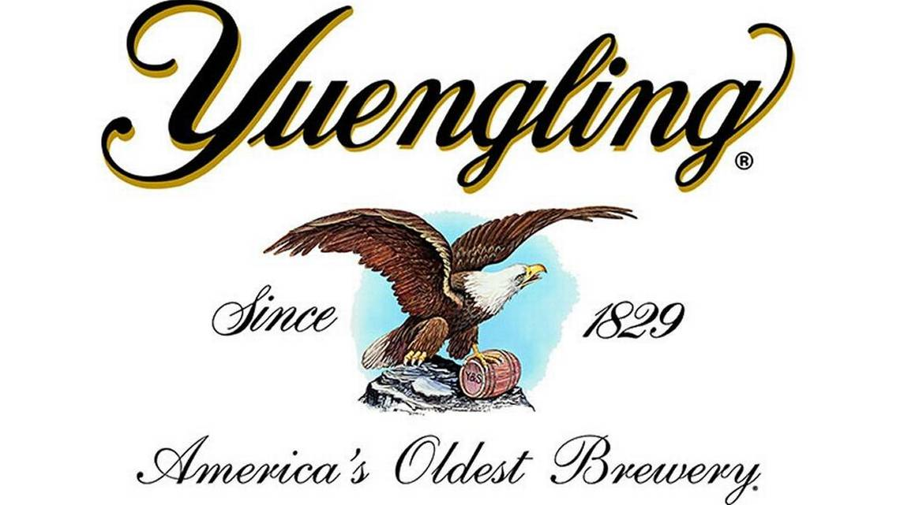




Step 1:What beer do you usually drink?

Slide 5
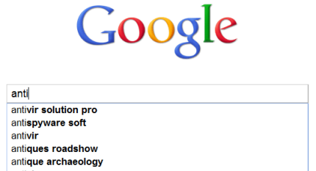
Craft Cans
S
Sierra Nevada
Samuel Adams Boston Lager
Sea Dog Wild Blueberry Wheat Ale
Skull Splitter Orkney Ale
Smuttynose Winter Ale
Snake Chaser Irish Style Stout
Sweetwater IPA

Slide 6
Craft Cans
Sweetwater
Sweetwater IPA

Slide 7
Your Usual Choice

Slide 8
Craft Cans Suggestions

Slide 9
Suggestions made from these 3 things
A
B
C

